Slide 1


Computer Architecture Experiment
姜晓红
College of Computer Science & Engineering
Zhejiang University

Slide 2
Topics
0、Basic Knowledge
1、Function Units Design
2、Single-cycle CPU Design
3、Multiple-cycle CPU Design
4、5-stage of pipeline CPU Design
5、Pipelined CPU with stall
6、Pipelined CPU with forwarding
7、Pipelined CPU resolving control hazard
8、Pipelined CPU support execution 31 MIPS Instructions
9、Course Review

Slide 3
Outline
Experiment Purpose
Experiment Task
Basic Principle
Operating Procedures
Precaution

Slide 4
Experiment Purpose
Understand the principles of CPU Controller and master methods of CPU Controller design
Understand the principles of Datapath and master methods of Datapath design
Understand the principles of Single-cycle CPU and master methods of Single-cycle CPU design
master methods of program verification of CPU

Slide 5
Experiment Task
Design the CPU Controller of Single-cycle CPU
Design the Datapath, bring together the basic units into Single-cycle CPU
Verify the CPU with program and observe the execution of program

Slide 6
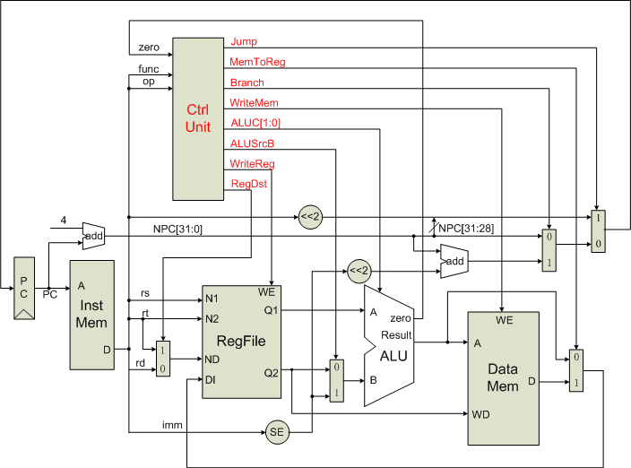

CPU Controller

Slide 7
Output of CPU Controller
NO | Signal | Meaning when signal is 1 | Meaning when signal is 0
1 | RegDst | rd | rt
2 | ALUsrcB | Extended-Imm. | register
3 | MemtoReg | Mem. output | ALU output
4 | RegWrite | Write to Register file, the addr is up to RegDst, the data is up to MemtoReg | Not write to Register file
5 | MemWrite | Write to Memory | Not write to memory
6 | Branch | Branch addr. | Not branch
7 | Jump | Jump addr. | Branch addr
8 | ALUC[1:0] | ALU operation code

Slide 8
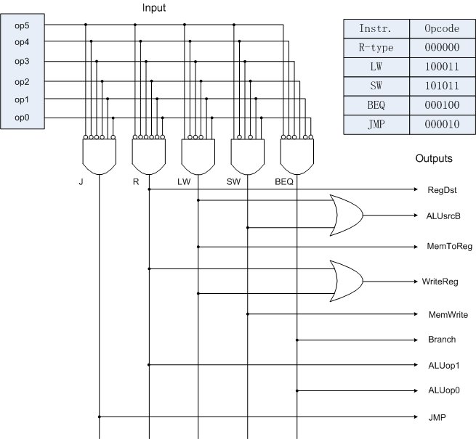
The principle of CPU Controller

Slide 9
The Datapath of Single-cycle CPU

Slide 10
Basic Units of Single-cycle CPU
CPU Controller
ALU and ALU Controller
Register file
Instruction Mem. and Data Mem.
others：Register, adder, sign-extend Unit, shifter, multiplexor。

Slide 11
Memory
Instr. Mem.
  Single Port Block Memory
  Read only, Width:32
  Rising Edge Triggered
Data Mem.
  Single Port Block Memory
  Read and Write, Width:32, Read After Write
  Rising Edge Triggered

Slide 12
Single-cycle CPU Top Module（1）
assign and_out = alu_zero & branch;
assign pc_in = jump ? instr_out[8:0] : branch_mux_out[8:0];
single_pc x_single_pc(clk,rst,pc_in,pc_out);
c_instr_mem x_c_instr_mem(pc_out,disp_clk,instr_out);
single_pc_plus4 x_single_pc_plus4(pc_out,pc_plus_4);
single_mux5 x_single_mux5(instr_out[20:16],instr_out[15:11],regdst,reg3_out);
single_gpr x_single_gpr(rst,clk,instr_out[25:21],instr_out[20:16],tmp_sel,reg3_out,wdata_out,regwrite,reg1_dat,reg2_dat, pr_disp_out);
single_aluc x_single_aluc(aluop,instr_out[5:0],alu_ctrl);
single_signext x_single_signext(instr_out[15:0],signext_out);
single_mux32 x_single_mux32(reg2_dat,signext_out,alusrc,mux_to_alu);

Slide 13
Single-cycle CPU Top Module（2）
single_alu x_single_alu(reg1_dat,mux_to_alu,alu_ctrl,alu_zero,alu_out);
c_dat_mem x_c_dat_mem(alu_out[8:0],disp_clk,reg2_dat,mem_dat_out,memwrite);
single_mux32 x_single_mux32_2(alu_out,mem_dat_out,memtoreg,wdata_out);
single_add x_single_add(signext_out,{{23'b0},pc_plus_4},branch_addr_out);
single_mux32 x_single_mux32_3({{23'b0},pc_plus_4},branch_addr_out,and_out,branch_mux_out);
single_ctl x_single_ctl(rst,instr_out[31:26],regdst,jump,branch,memread, memtoreg,aluop,memwrite,alusrc,regwrite);

Slide 14
Debug Info(1)
Input
  West Button: Step execute
  South Button: Reset
  Slide Button: Address of Register
Output
  0-7 Character of First line: Instruction Code
  8 of First line : Space
  9-10 of First line : Clock Count.
  11 of First line : Space
  12-13 of First line : PC
  0-3 of Second line : Selected Register Content

Slide 15
Debug Info(2)
  strdata[255:248] = 8'h30 + instr_out[31:28];
  strdata[247:240] = 8'h30 + instr_out[27:24];
  strdata[239:232] = 8'h30 + instr_out[23:20];
  strdata[231:224] = 8'h30 + instr_out[19:16];
  strdata[223:216] = 8'h30 + instr_out[15:12];
  strdata[215:208] = 8'h30 + instr_out[11:8];
  strdata[207:200] = 8'h30 + instr_out[7:4];
  strdata[199:192] = 8'h30 + instr_out[3:0];
  strdata[183:176] = 8'h30 + clk_cnt[7:4];
  strdata[175:168] = 8'h30 + clk_cnt[3:0];
  strdata[159:152] = 8'h30 + pc_out[7:4];
  strdata[151:144] = 8'h30 + pc_out[3:0];
  strdata[127:120] = 8'h30 + gpr_disp_out[15:12];
  strdata[119:112] = 8'h30 + gpr_disp_out[11:8];
  strdata[111:104] = 8'h30 + gpr_disp_out[7:4];
  strdata[103:96] = 8'h30 + gpr_disp_out[3:0];

Slide 16
Program for verification
//requirement: calculate 1+2+3+ … + 10
0 Lw $1, 0($0) //$1 = 1: step
1 Lw $2, 4($0) //$2 = 0: sum
2 Lw $4, 1($0) //$4 = 11: upper
3 Add $3, $1, $2 //$3 = 1: index
4 repeat: add $2, $3, $2 //$2=$2+$3
5 add $3, $3, $1 //$3=$3+1
6 beq $3, $4, out //if($3==$4) goto out
7 j repeat; //else goto repeat
8 out: sw $2, 2($0)； //save $2 to 2($0)
DataMem(0) = 1; DataMem(1) =11;DataMem(4)=0;

Slide 17
Precaution
Task 1: Waveform Simulation
Task 2: FPGA
  Anti-Jitter Push button
  Edit .coe file using notepad
  It takes so long time to generate programming file, so u may check the code carefully before u synthesize it.
Report should be written in English

Slide 18
Thanks!

